Slide 1
形式语言与自动机（一）
代立云
dailiyun@swu.edu.cn

Slide 2
课程主页
https://github.com/djuanbei/AutomataClass
助教 吴贵森 1019661562@qq.com

Slide 3
课程目标
掌握有限自动机的基本理论
掌握正则表达式的基本理论
能实现有限自动机和正则表达式的基本算法
掌握上下文无关语言的基本结论和实现下文无关语言的基本算法
掌握图灵可计算模型
掌握P/NP问题的概念
掌握SAT问题求解算法

Slide 4
考核方式
平时成绩（30%）：
课堂考勤 （10%）基本分10%，采用扣分制：一次缺勤扣 2% 直到扣满10%.
讨论表现 （20%）采用加分制： 提一个问题加2%直到满 10%, 回答一个问题加 2% 直到满 10%.
大作业(70%)
UNIX正则匹配程序 （20%）
XML语言解析程序 (20%)
SAT求解器 (30%)

Slide 5
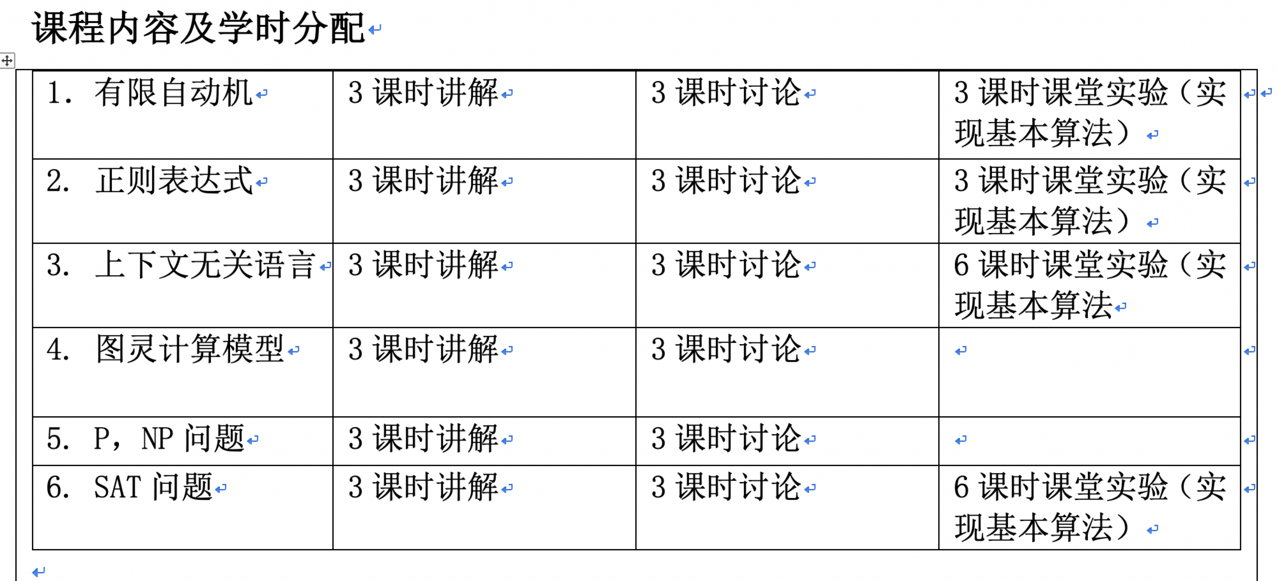

Slide 6
Finite Automata
On/Off switch example
Modeling recognition of the word “then”
action
Push
Start
off
on
state
Push
Start
t
t
h
th
e
the
n
then
Start state
Transition
Intermediate
State
Final
State

Slide 7
A complex example
The Ground Rules
The customer may decide to pay.
The customer may decide to cancel.􏰆
The store may ship goods to the customer.
The store may redeem the money.
The bank may transfer the money by creating a new suitably encrypted money file and sending it to the store􏰆

Slide 8
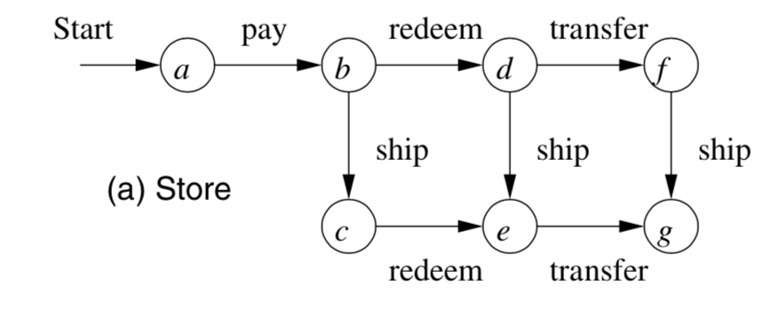
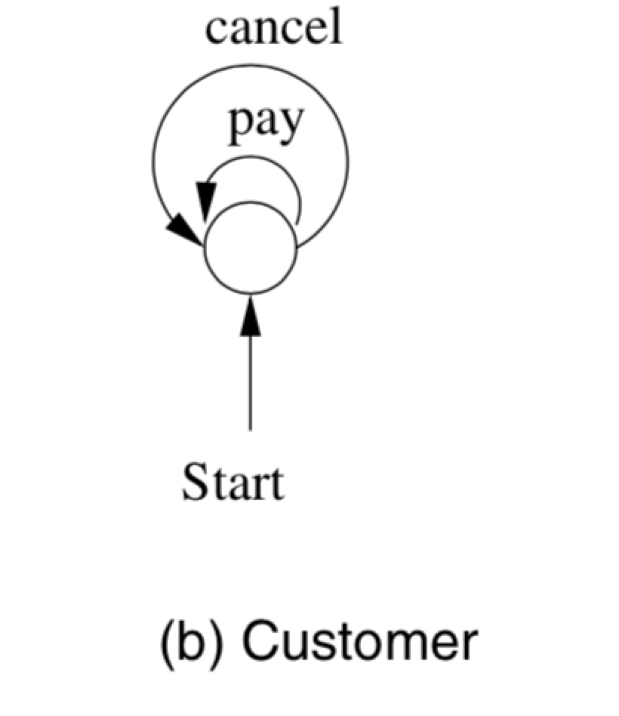
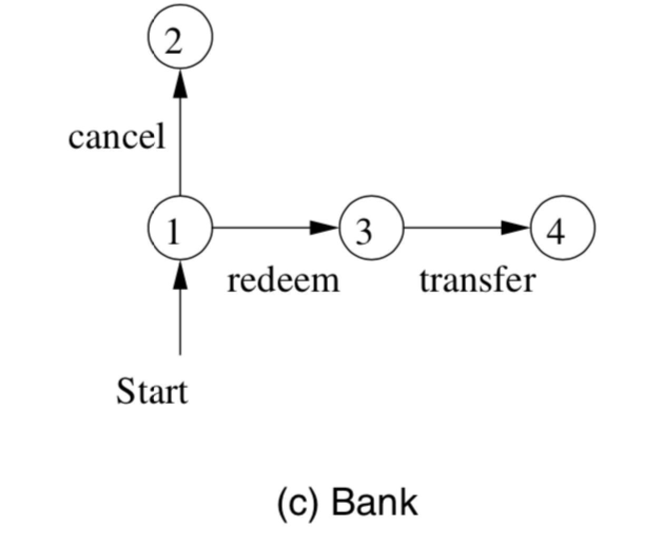
Finite automata representing

Slide 9
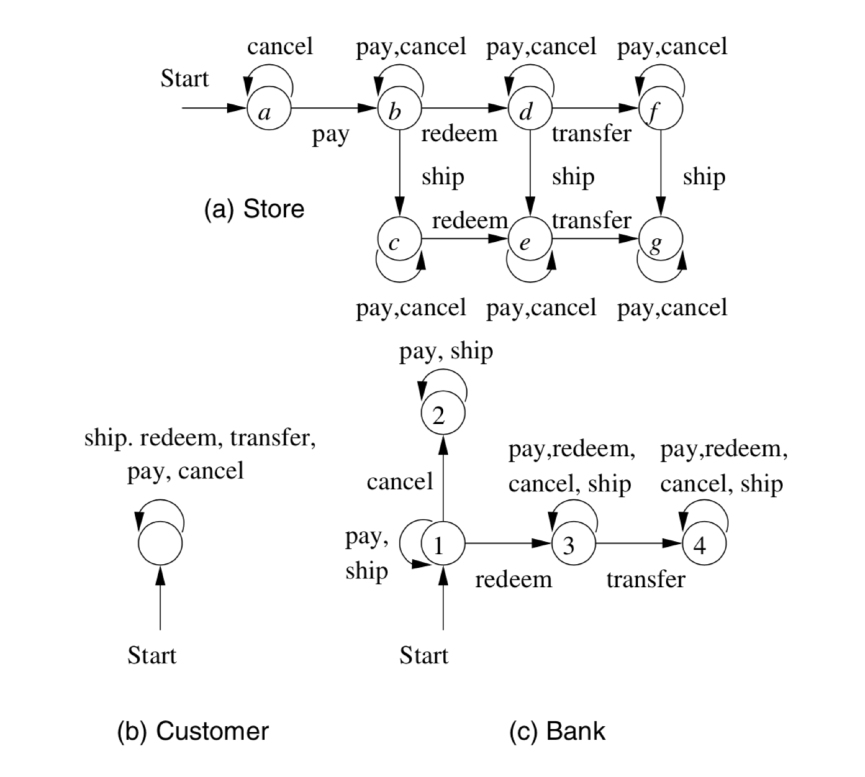
Enabling the automata to Ignore Action

Slide 10
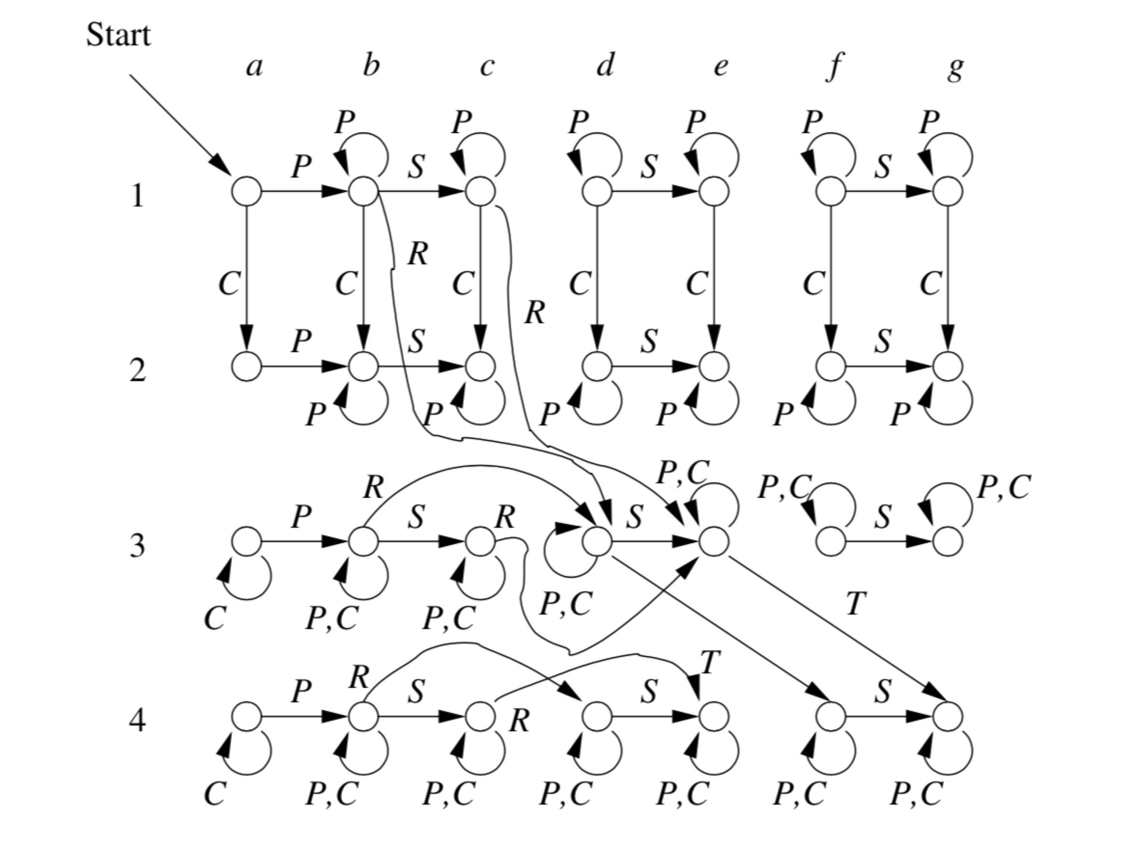
Product automaton

Slide 11
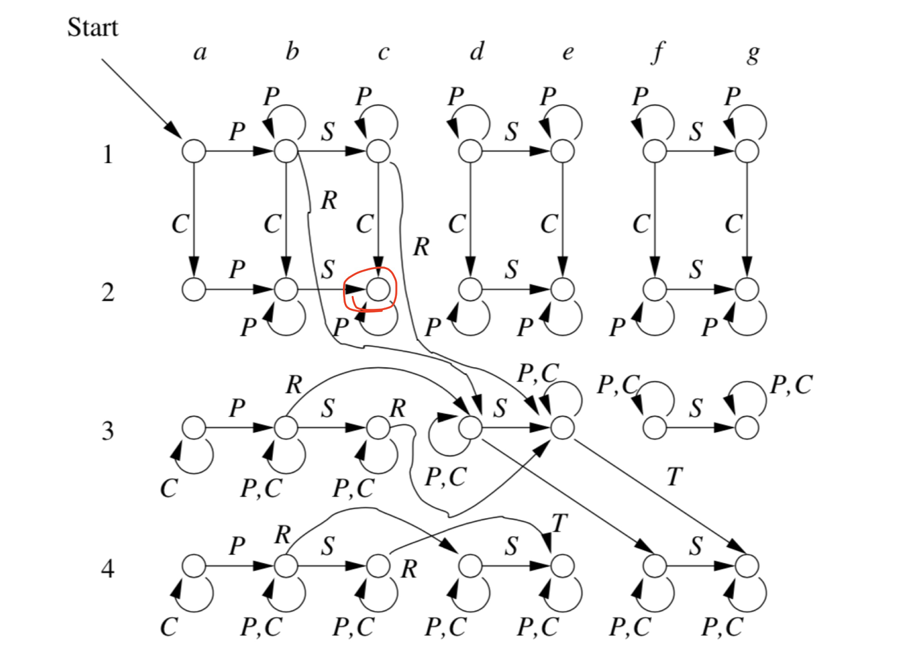
Using the Product Automaton to Validate the Protocol

Slide 12
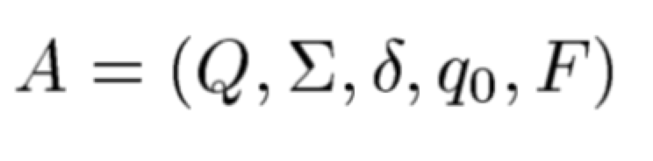
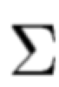
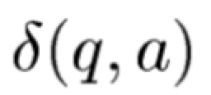
Deterministic Finite Automata
A Deterministic Finite Automata (DFA) including 5-tuple
A finite set of states, often denoted Q.
A finite set of input symbols, often denote
A transition function that takes as arguments a state and an input symbol
A start state, one of the states in Q.
A set of final or accepting state F. The set F is a subset of Q.

Slide 13
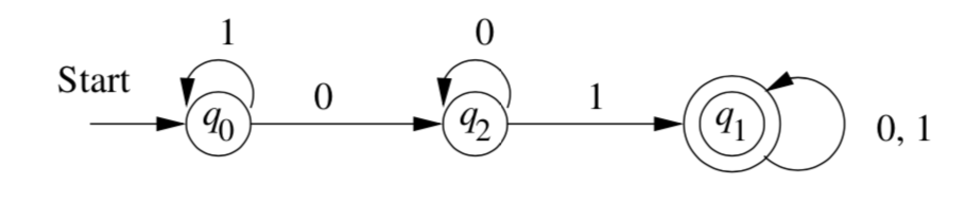
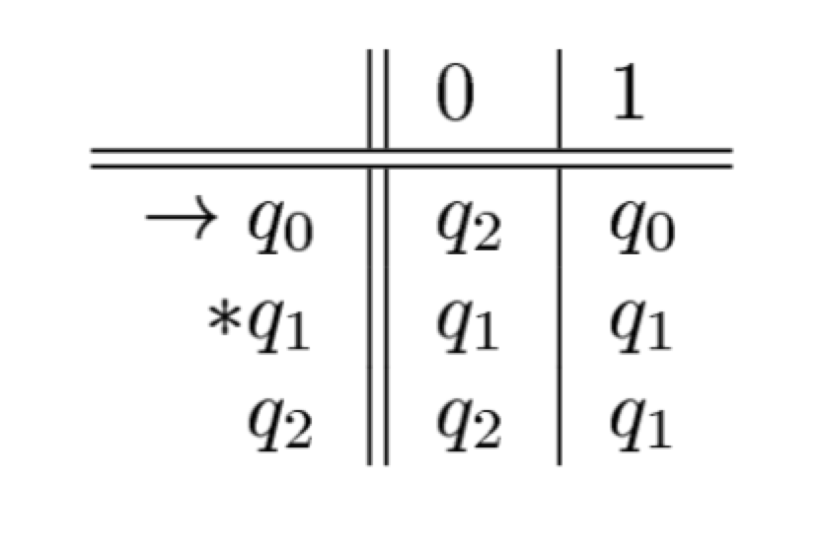
Simpler Notations for DFA
Transition Diagrams
Transition Tables

Slide 14
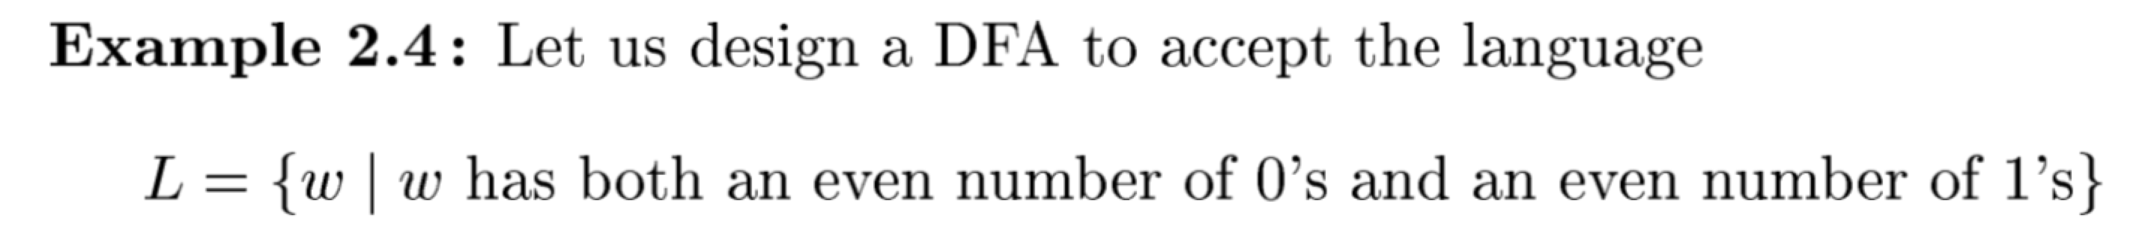
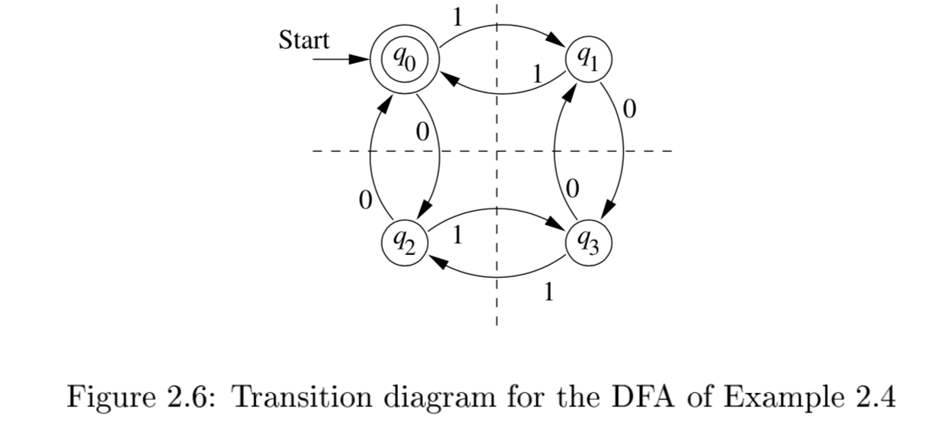
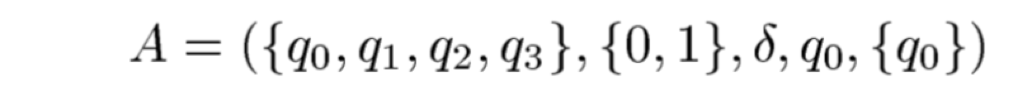
Example

Slide 15
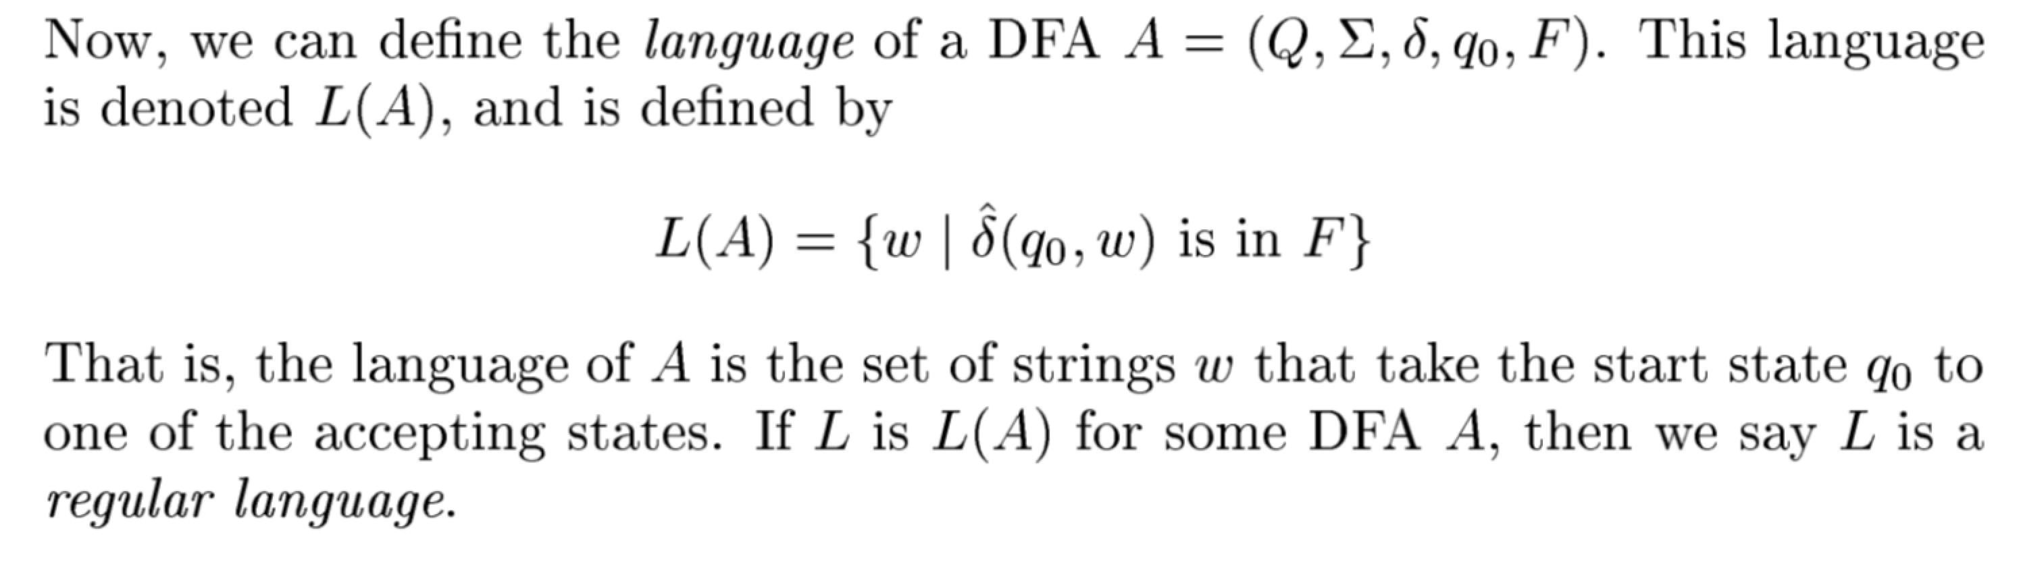
The Language of a DFA

Slide 16
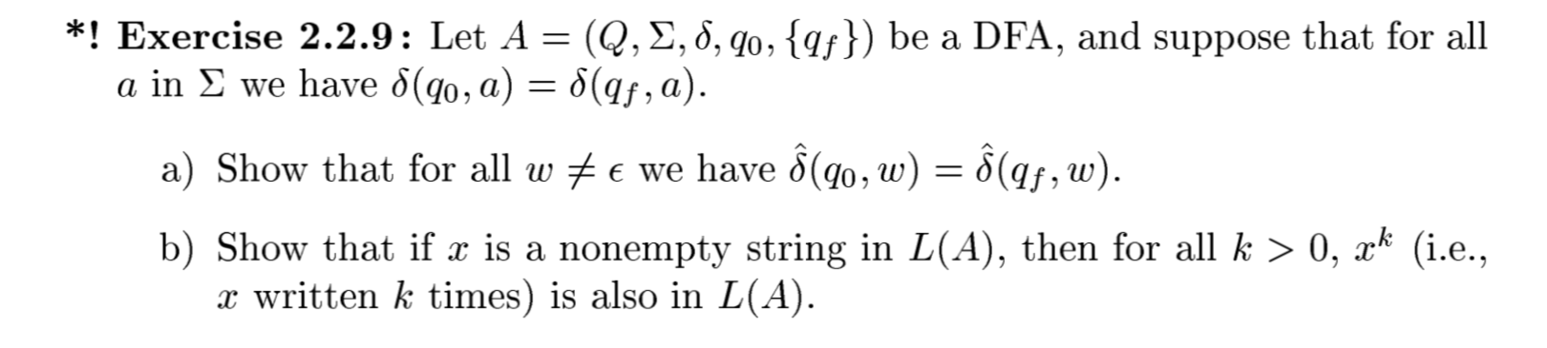
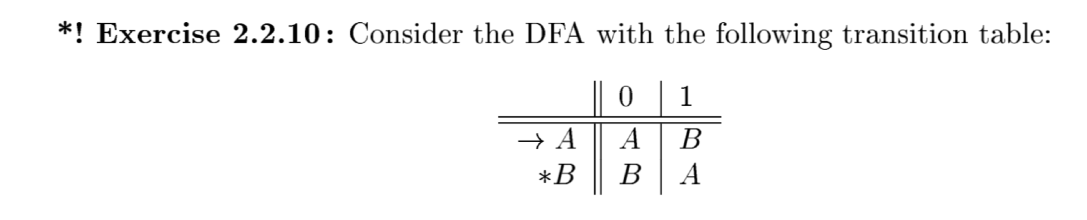
Exercise

Slide 17
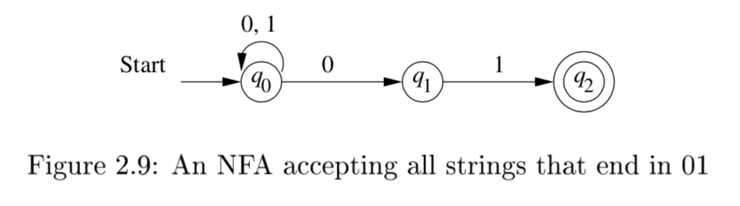
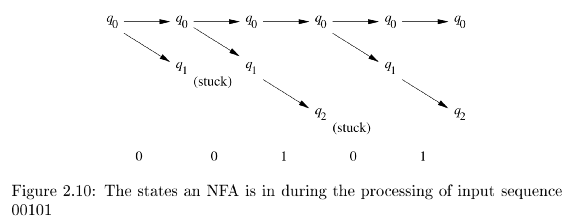
Nondeterministic Finite Automata（NFA）
Example

Slide 18
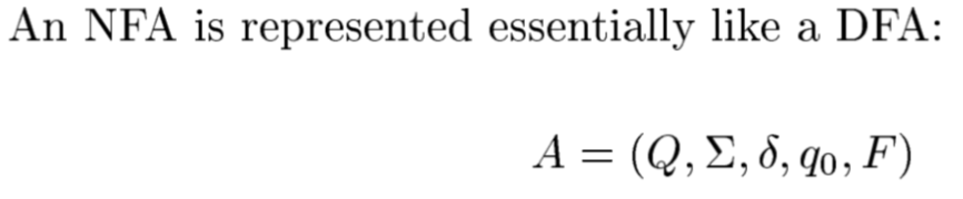
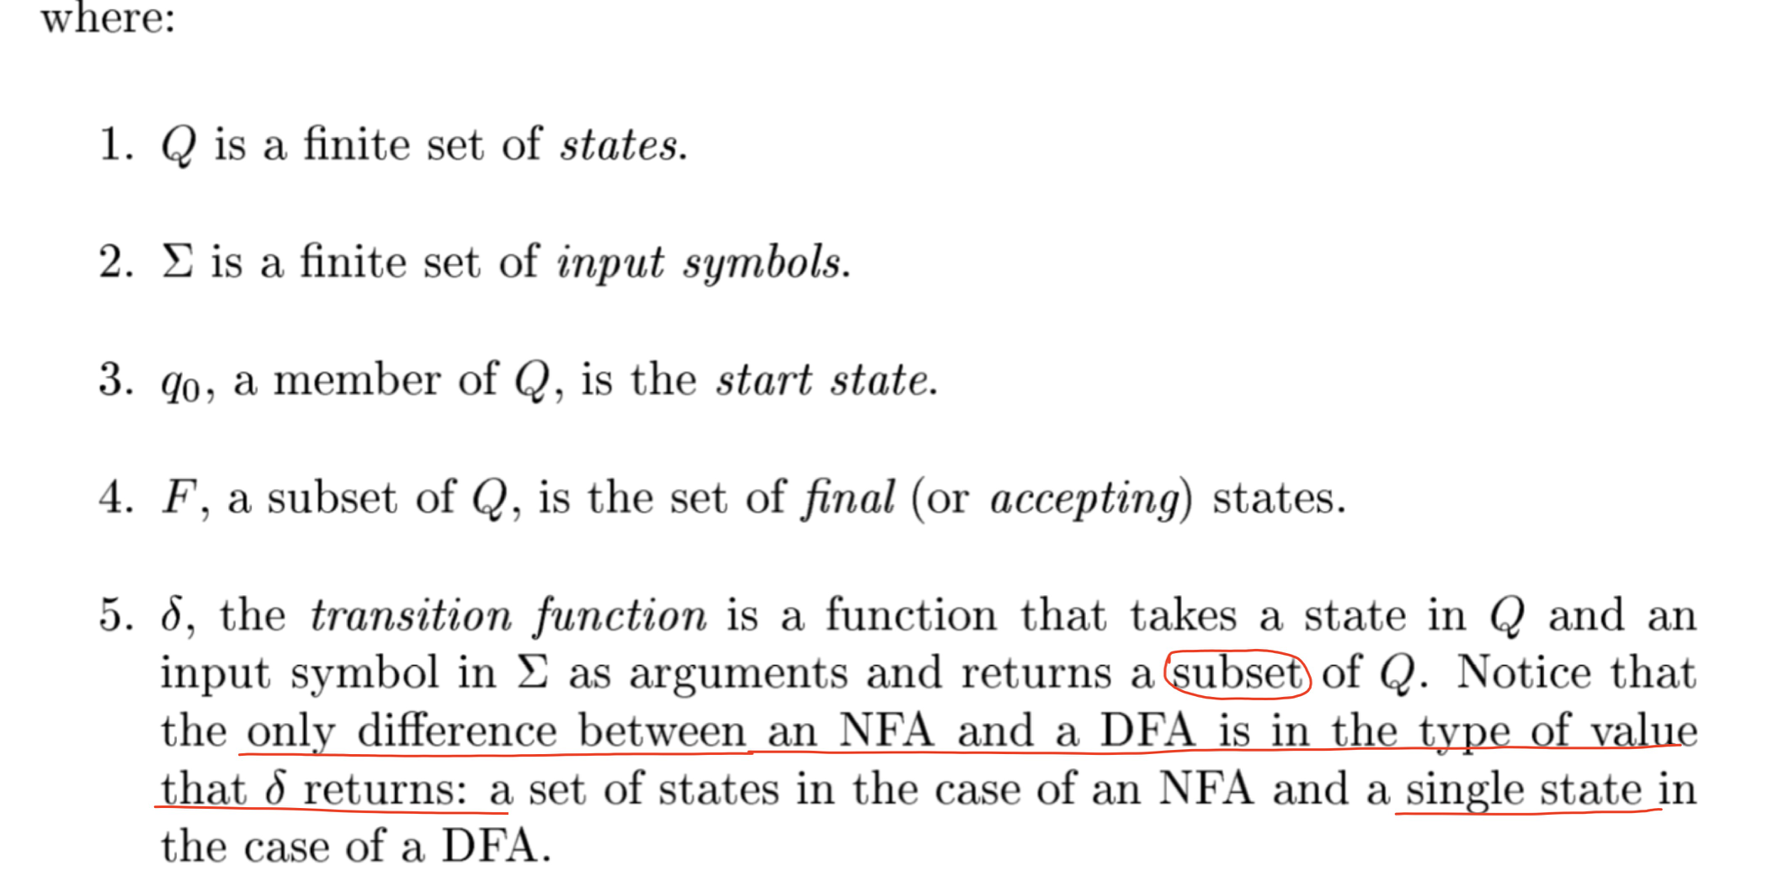
Definition of Nondeterministic Finite Automata

Slide 19
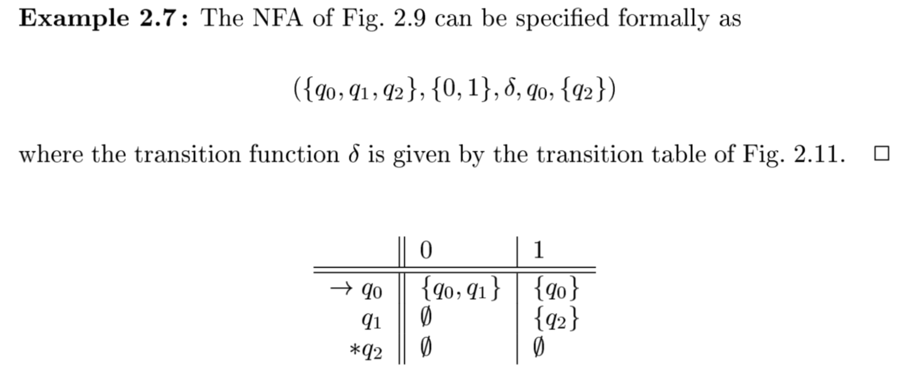
Example

Slide 20
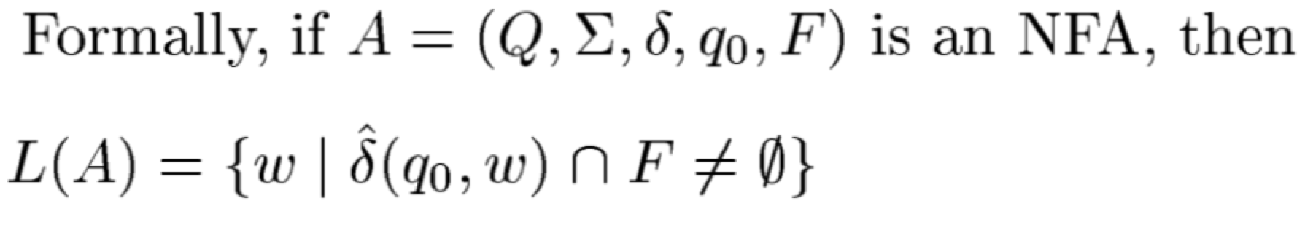
The Language of an NFA

Slide 21
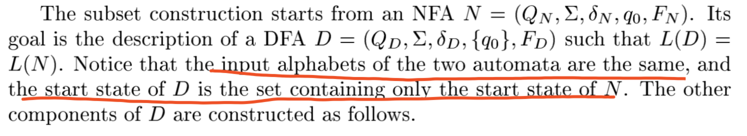
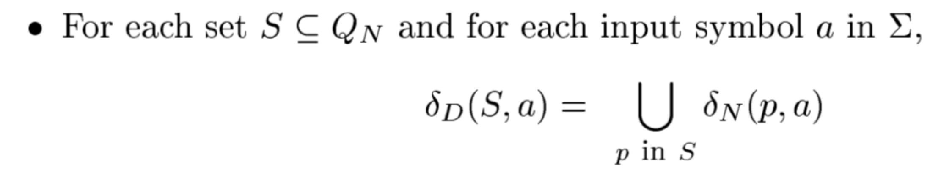
Equivalence of DFA and NFA

Slide 22
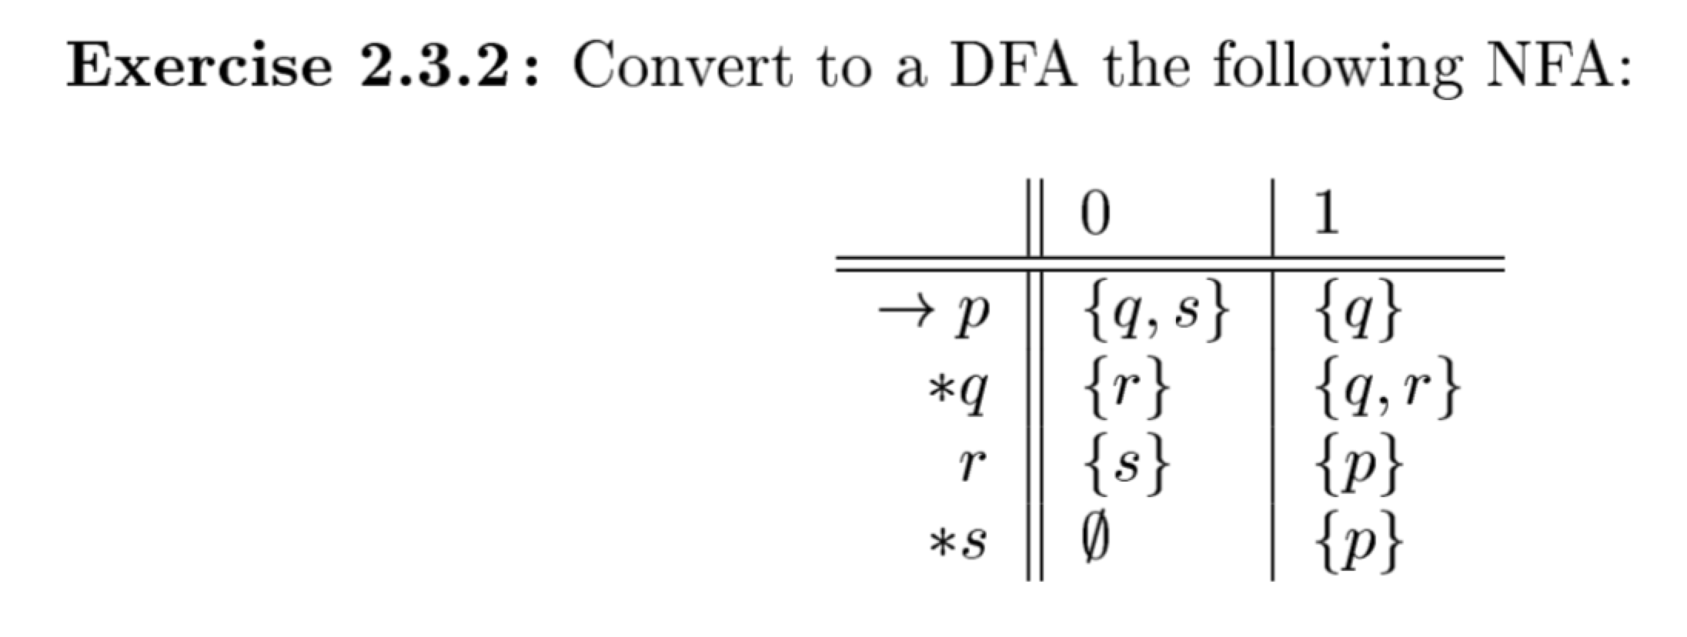
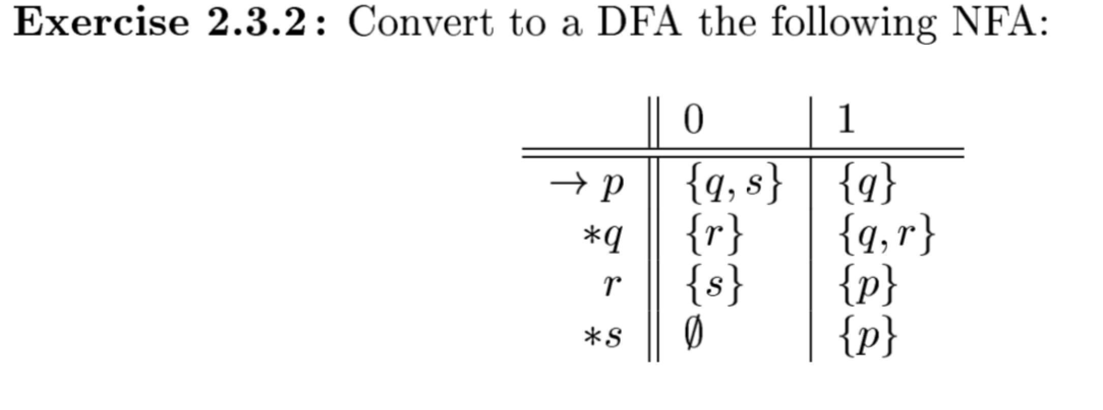
Exercise

Slide 23
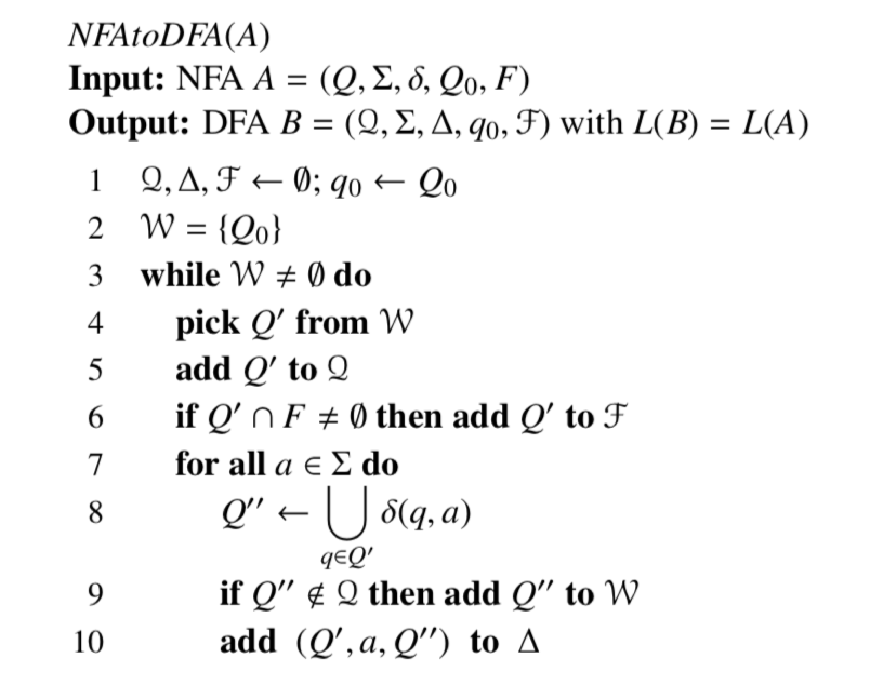
Algorithm

Slide 24
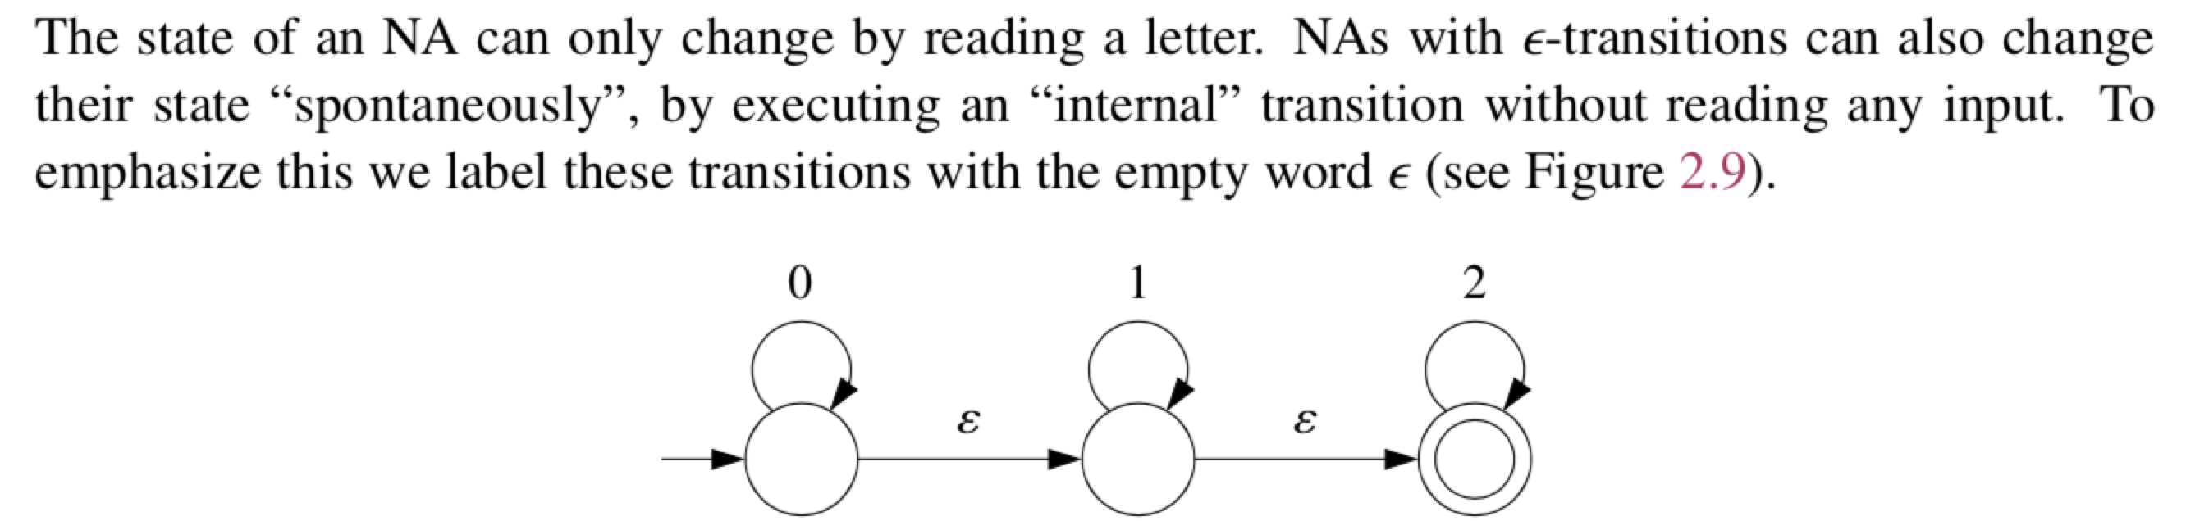
Non-deterministic finite automata with ε-transitions

Slide 25
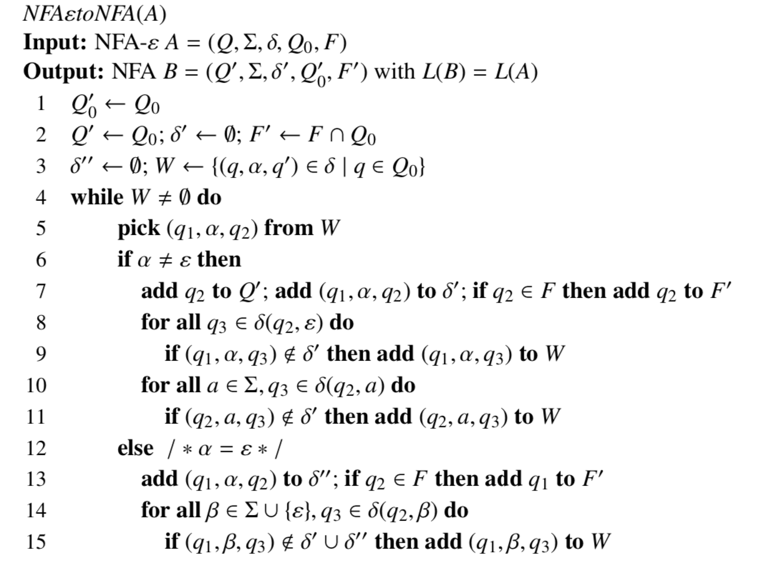
NFAεtoNFA

